Slide 1

Combinations Decrease and Conquer Algorithm
Ahmed Ibrahim Mohamed
224189

Slide 2

Problem Definition:
Given a set of distinct elements: {1, 2, 3}
We want to generate all combinations of size k=2.
Ahmed Ibrahim Mohamed
224189
Strategy : Decrease and conqer
Goal : [1, 2][1, 3][2, 3]
Combinations Decrease and Conquer Algorithm

Slide 3
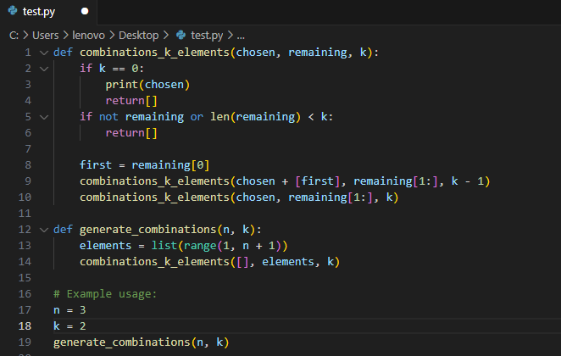
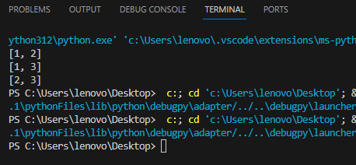
The implementation
Ahmed Ibrahim Mohamed
224189
Combinations Decrease and Conquer Algorithm
Problem Definition:
Strategy:
Given a set of distinct elements: {1, 2, 3}
We want to generate all combinations of size k=2.
Goal : [1, 2][1, 3][2, 3]

Slide 4
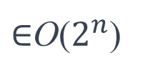
The Analysis :
The implementation
T(n , k)= T(n−1,k−1) + T(n−1,k) + O(1)
O( n! / k!(n-k)! ​)
Ahmed Ibrahim Mohamed
224189
$∈$O($2^{n}$)
Combinations Decrease and Conquer Algorithm
Problem Definition:
Strategy:
Given a set of distinct elements: {1, 2, 3}
We want to generate all combinations of size k=2.
Goal : [1, 2][1, 3][2, 3]

